Slide 1
Metallic Clashers Art Bible
Anh T., Brandon P., Jonah M.

Slide 2
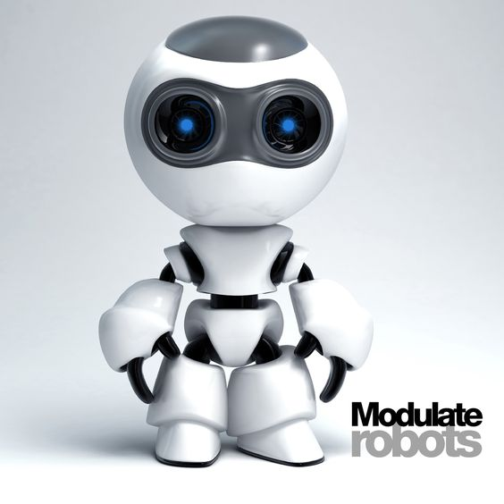

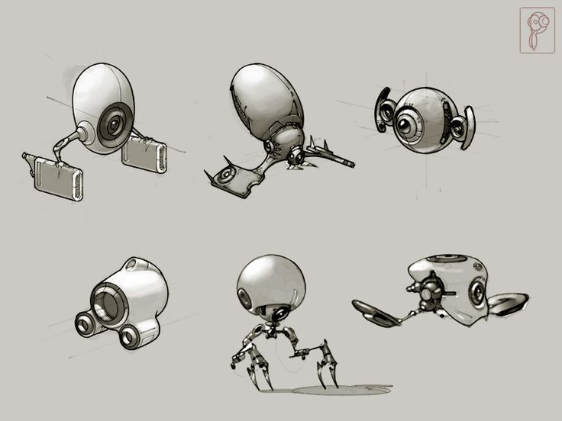
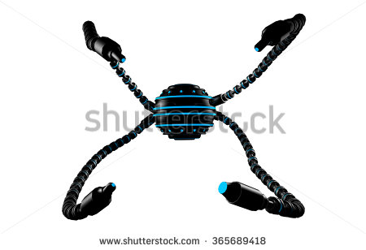
Research
Robot designs inspiration

Slide 3
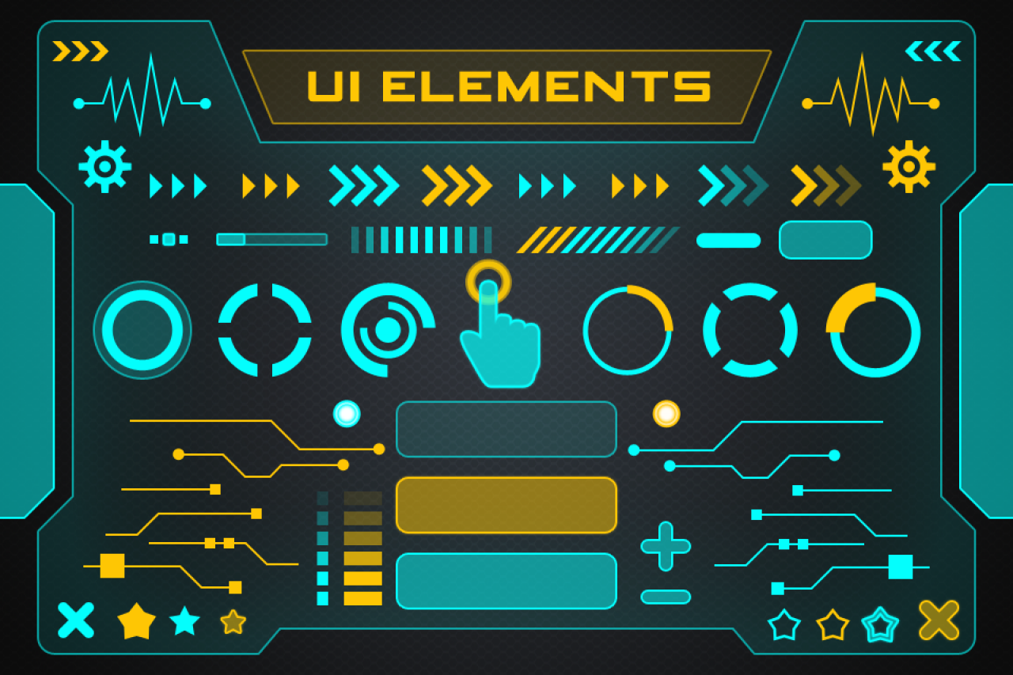
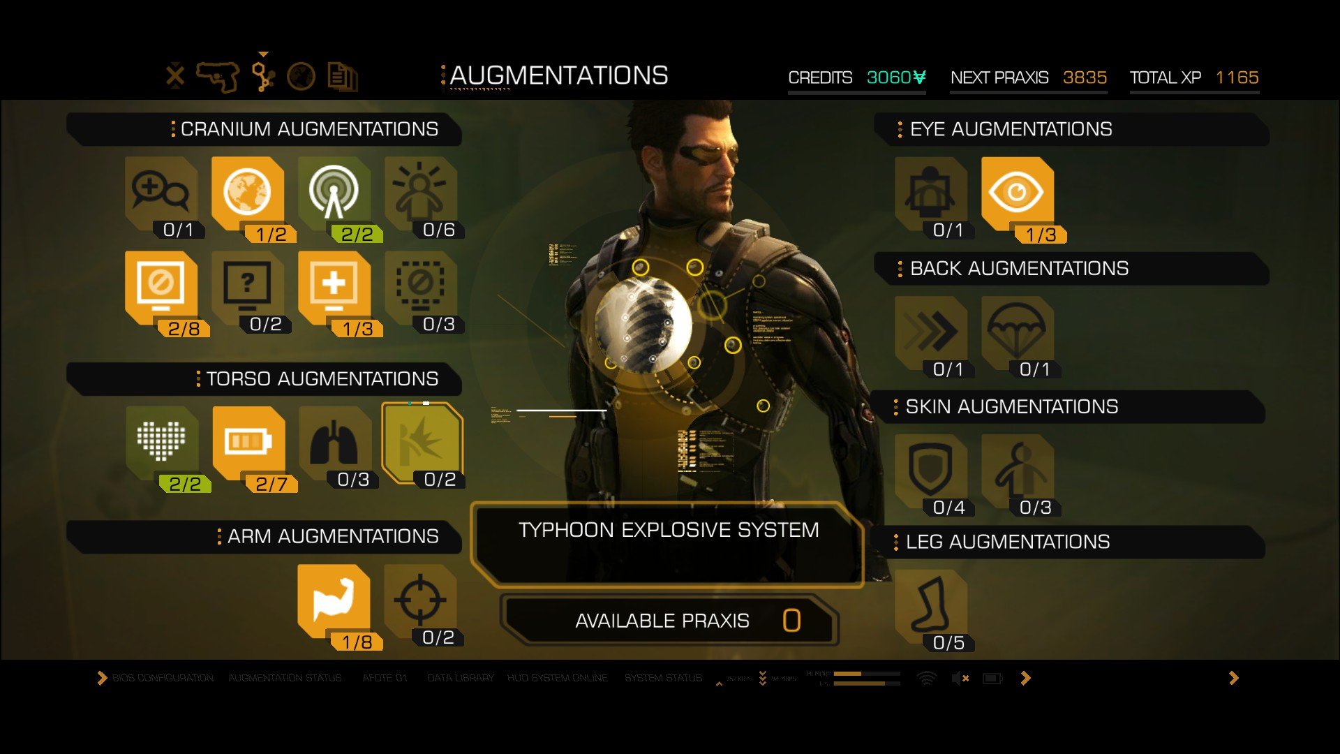
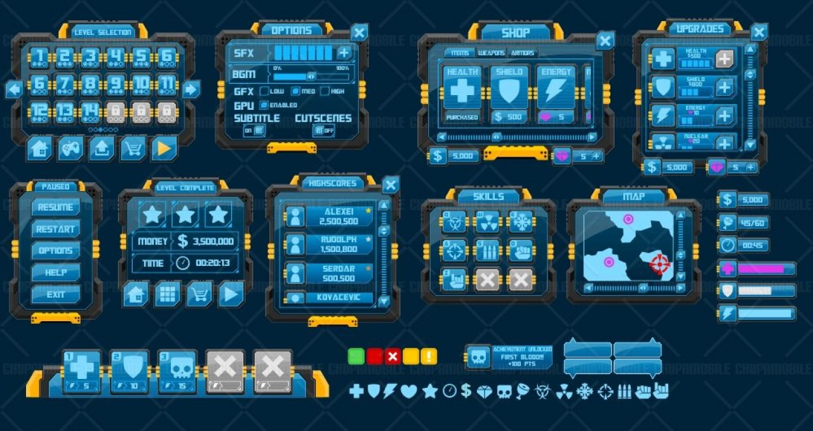
Research cont.
UI inspiration

Slide 4
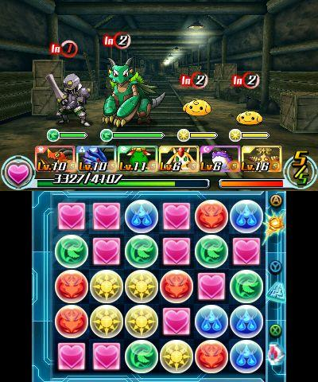
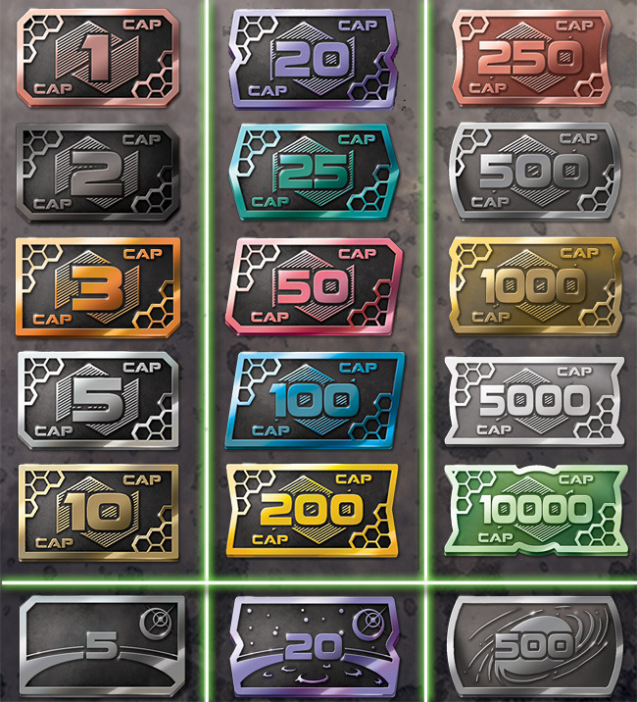
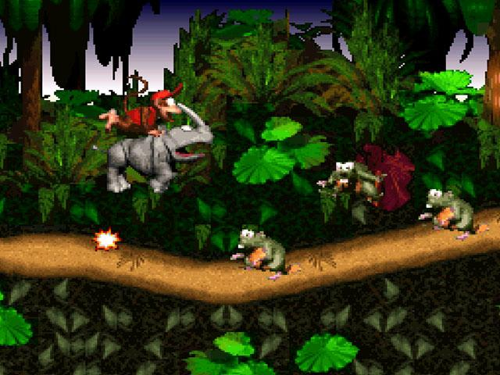
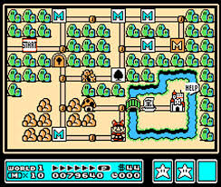
References
(Above) Model inspiration (Middle) UI inspiration (Right upper) Tokens color palette inspiration (Right bottom) Stage select inspiration

Slide 5
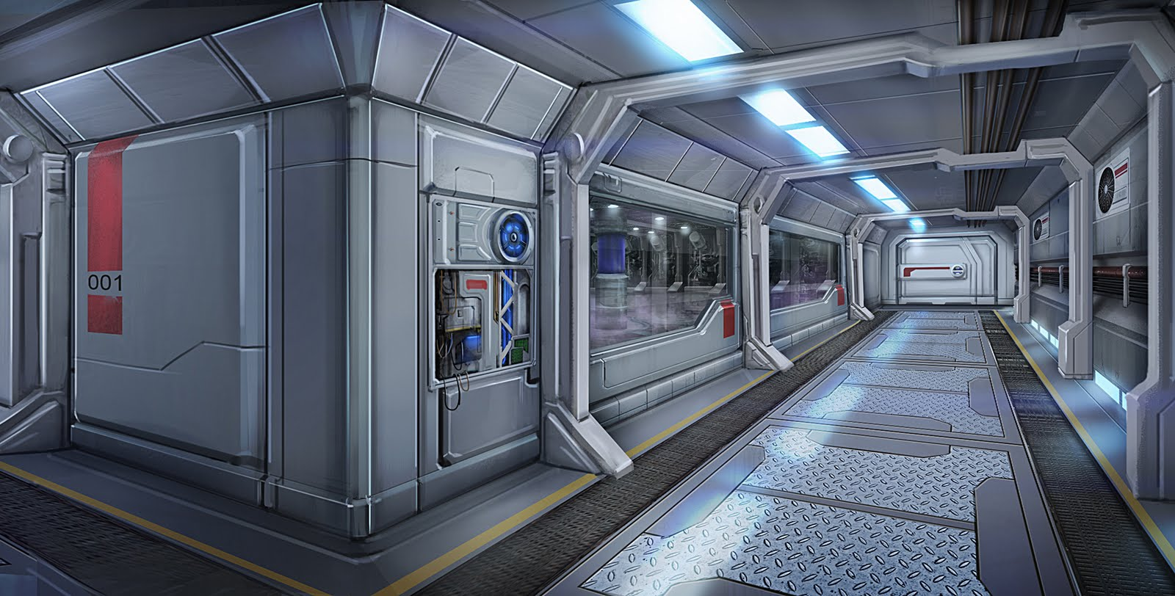
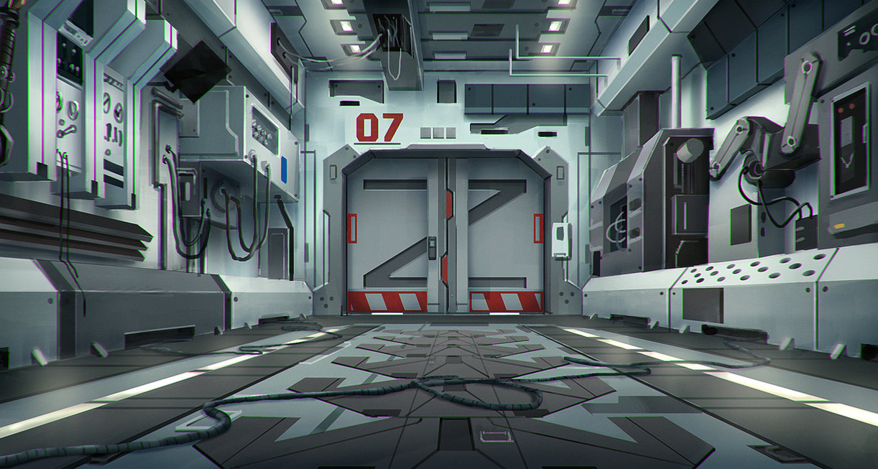
Mood Board
Sci-fi laboratory feel

Slide 6
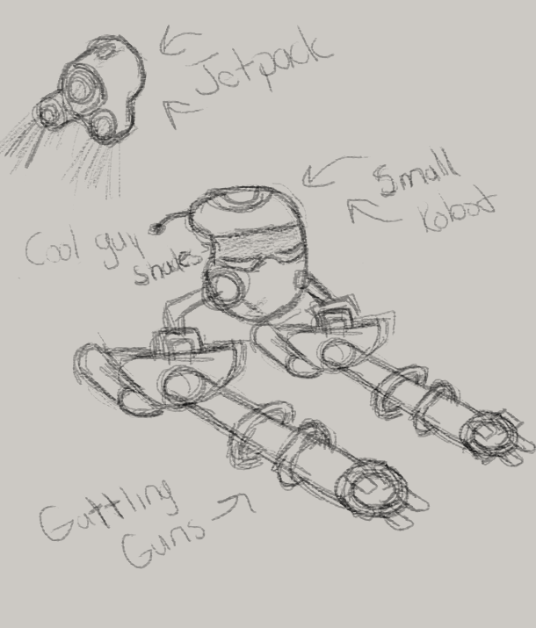
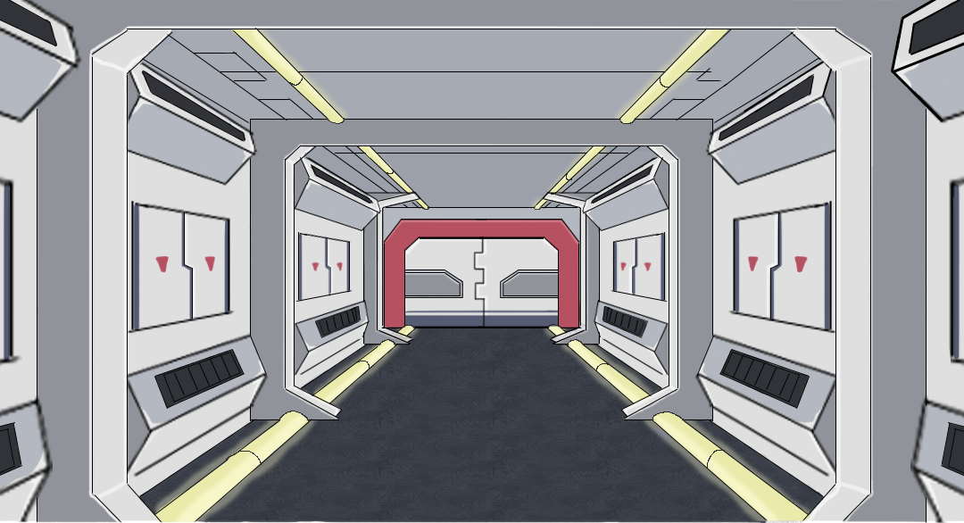


Concept art
(Left) Enemy background concept (Bottom left) Stage select node and guard token concepts (Right) Enemy concept

Slide 7
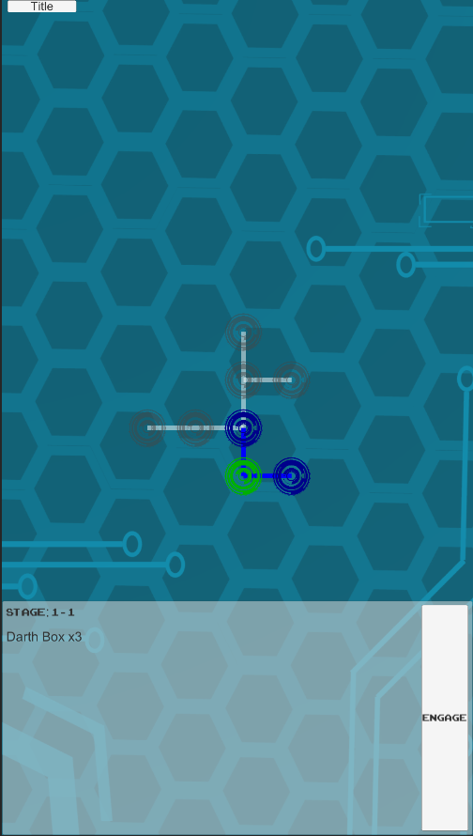
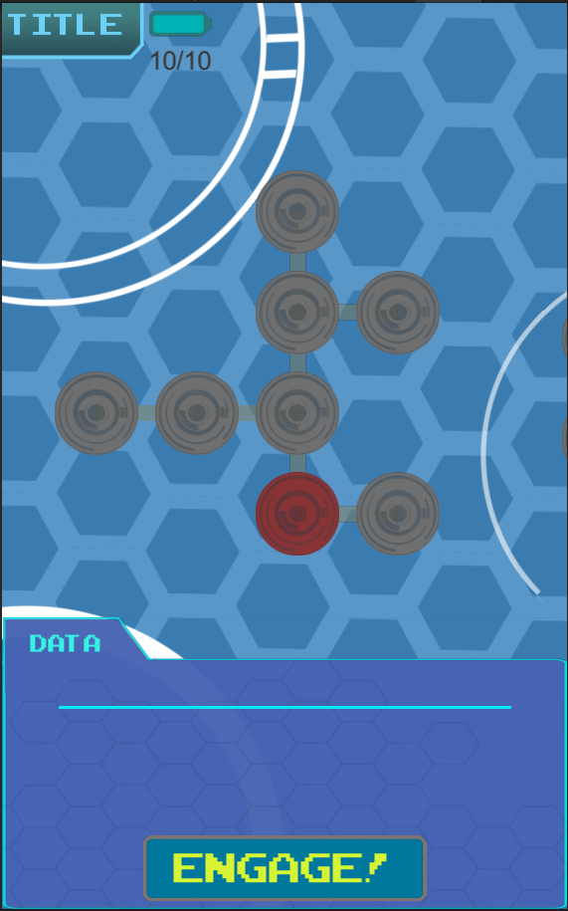
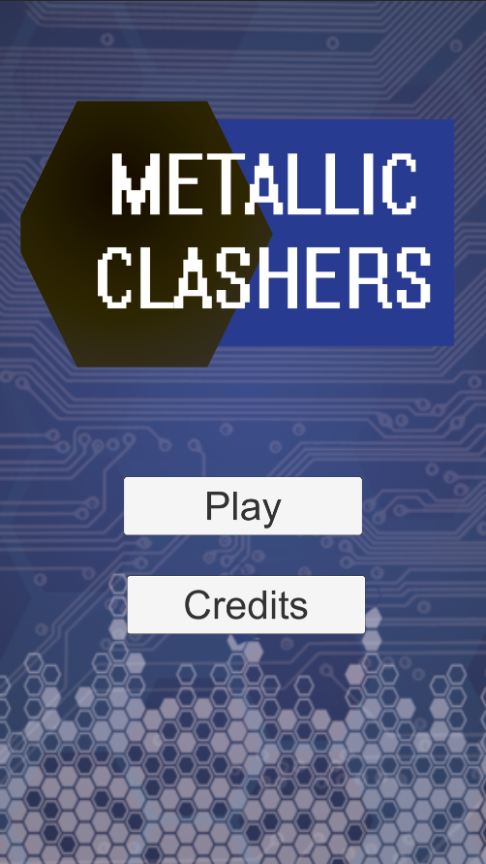
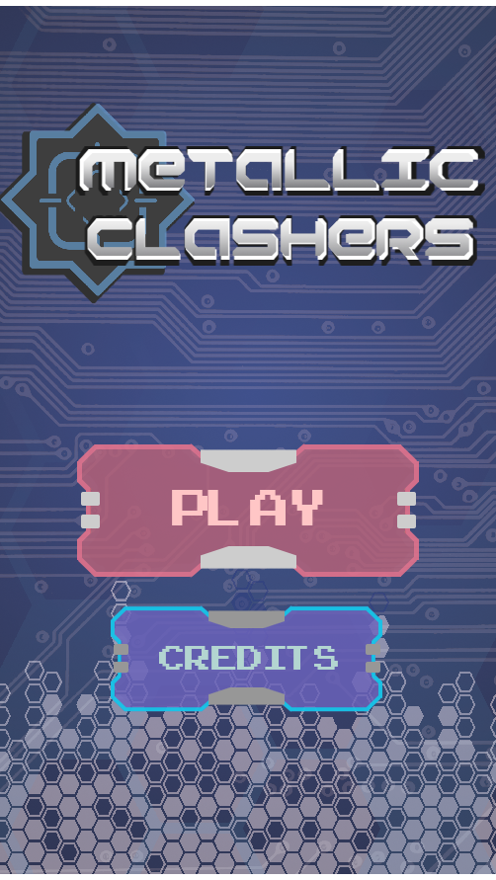
Concept art - Development
(Left) Old to new title screen (Above) Old to new stage select

Slide 8
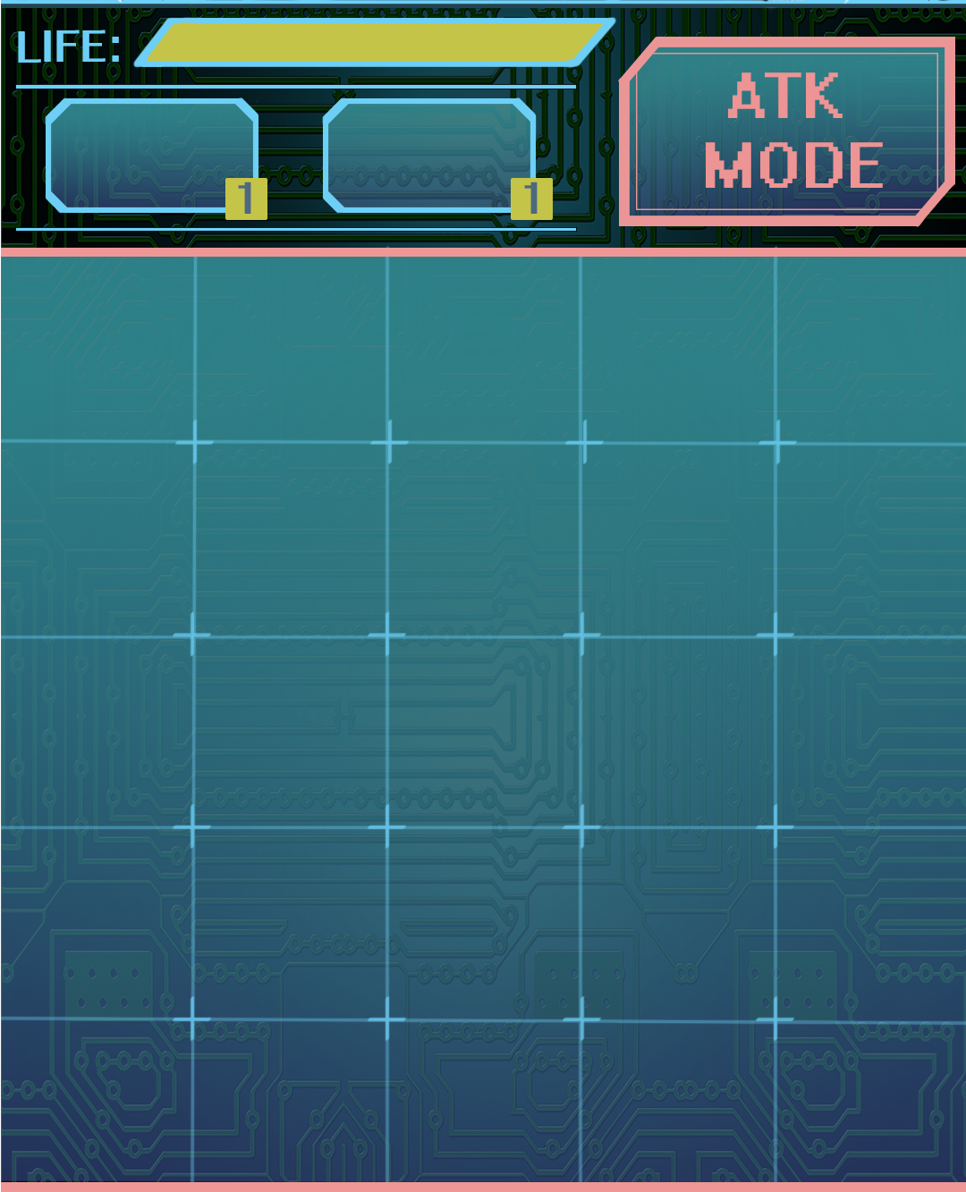
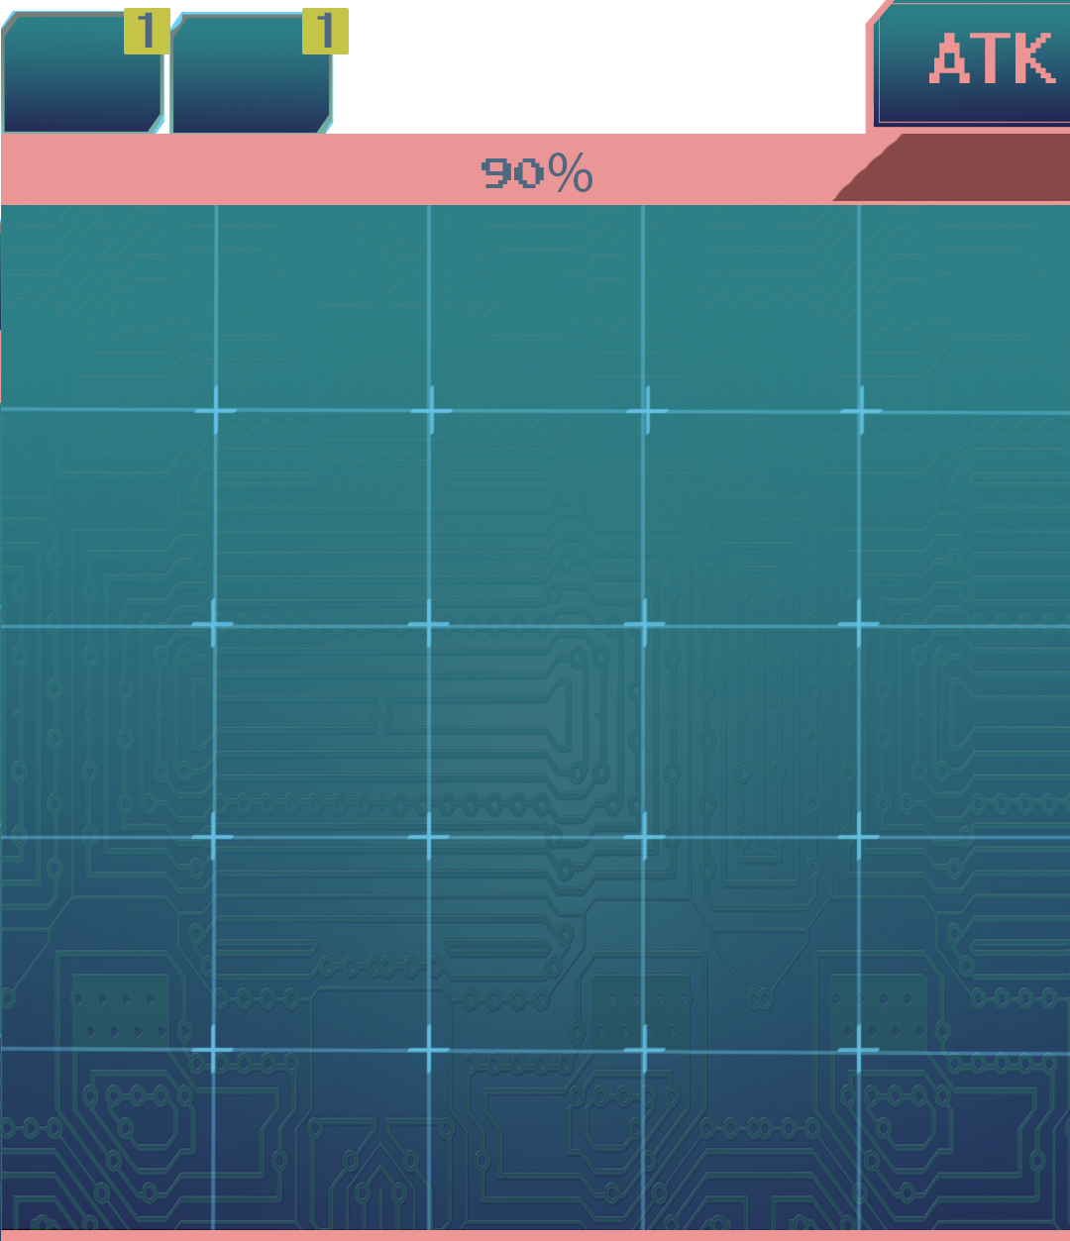


Concept art - Development cont.
(Left) Old to new combat UI (Above) Old to new attack tokens

Slide 9
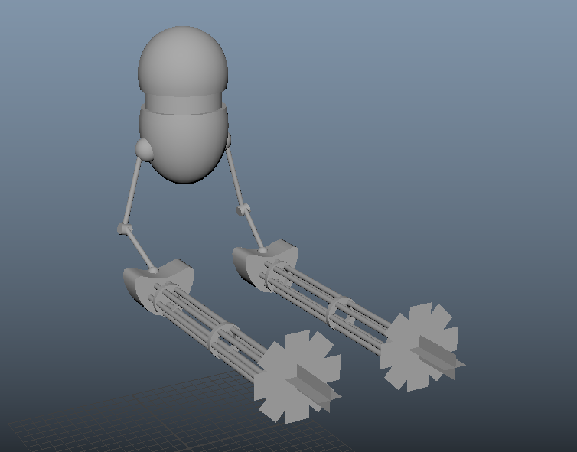
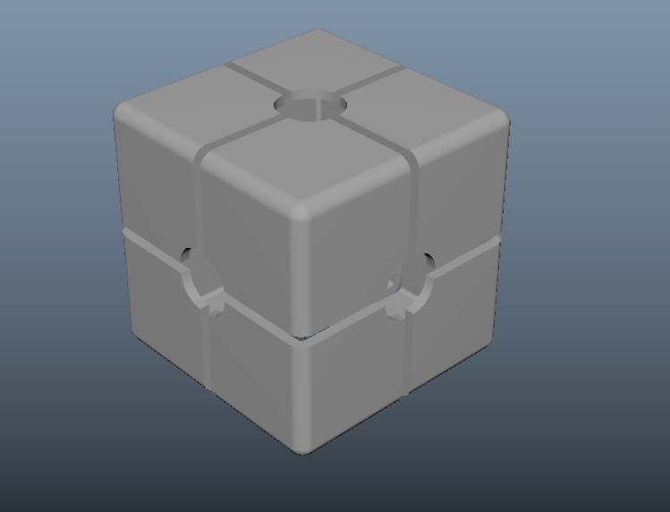
Enemy graybox

Slide 10




Programs
Maya, Photoshop, Substance Painter, Unity

